Slide 1
Enterprise Application Architecture Patterns

Slide 2
What is enterprise application?
Enterprise application
Accounting
Credit scoring
Financial analytics
Stock trading
Shipping tracking
Insurance
Non-enterprise application
Word processors
Elevator controllers
Telephone switches
Operating systems
Compilers
Games

Slide 3
Characteristics of enterprise applications
Persistent data (a lot of persistent data)
Concurrent access
Complicated ui
Complicated business logic
A lot of integrations with other enterprise applications
Huge codebase

Slide 4
Universal design solution?
One man’s junk is another man’s treasure.

Slide 5
Pattern
“Each pattern describes a problem which occurs over and over again in our environment, and then describes the core of the solution to that problem, in such a way that you can use this solution a million times over, without ever doing it the same way twice"
- Christopher Alexander

Slide 6
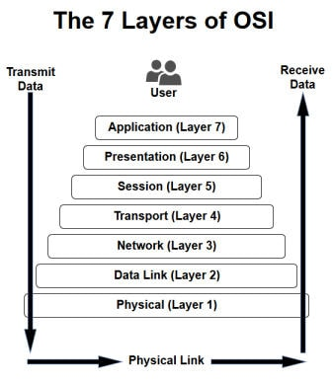
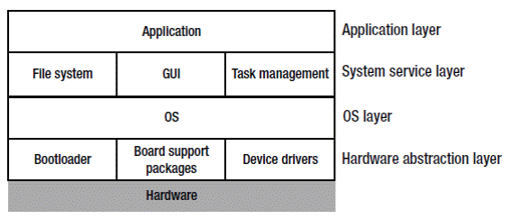
Layering
OS Layers

Slide 7
Benefits of layering
Layers are coherent
Layers minimize implementation-dependence
Can be substituted by other implementations
Layers are good for standardization
Layers can be reused

Slide 8
Drawbacks of layering
They encapsulate some, but not everything
Extra layers may harm performance
Suffer from cascade changes

Slide 9
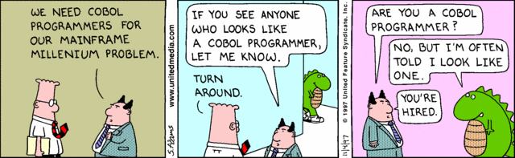
Age of Dinosaurs Mainframes
In the beginning was the COBOL, and the COBOL was with God, and the COBOL was God.

Slide 10
Age of Excel
“Do not think that I have come to abolish goto and spaghetti code; I have not come to abolish them but to teach them every indian on the Internet.”
- Alan Cooper, VB creator

Slide 11
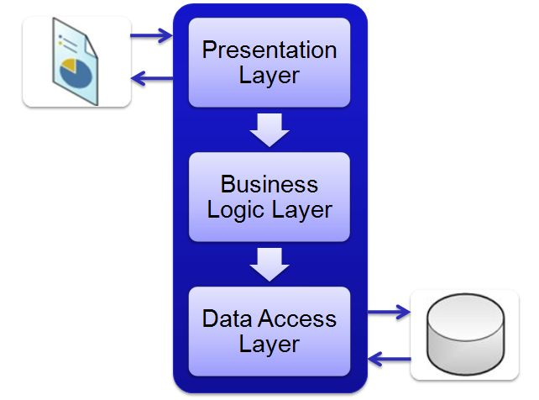
Three layered architecture

